Slide 1
2
Wealth, Eyes, face family
speech, food, journey
early education
nose, nail
Jup
Dhan Bhay
12
Expenditure, loss, feat, waste, foreign Journey jail, Imprisonment Inevitable
Events Bed Pleasure government
Punishment
Sat
Vyaya Bhav
3
Younger
siblings valour,
patience courage,
bone Neck, ear
anger, Self interest
servants
Mars
sahaj bhay
1
Nature
Birth, complexion, physical body qualities, fame characteristics, conduct
Sun
Tanu Bhay
11
Gains Titles
Honours
Achievements Elder
Siblings Success in life
Ears, Friends and relatives
Jup Aaya Bhav
4
Education
mother, land property,
conveyance, happiness,
Pleasures Heart, mind
Moon
Venus
Sukh Bhay
10
Reputation
respect.
Agricultural properties
Merit political success
professions, position prestigious deeds, dignity, honours. Achievements
Remuneration , environment and knees
Jup Sun Merc Sat Karma Bhav
5
Bhakti
Inclinations
son, education
scriptures Heart,
Wisdom Belly intestine
purva Janam Punya
Jup
Putra Bhay
9
Father
Spiritual
tendencies
religious
ceremonies devotion learning pilgrimage.
Association with legal & religious personalities
fate luck, leadership
groins long journey
Jup sun
bhagya
bhao
7
Spouse Marriage
Ambassador Foreign
Settlement Memory, knowledge
Positional achievements
commerce, milk partner, journey.
Venus
Jaya Bhay
6
Enemies
losses litigation,
debt disease, thief
wounds, anxiety taste, naval,
stomach
Sat Mars
Shatru Bhay
8
Longevity
Death, sudden
Financial gain, long illness
cause of death congeal life reproductive organ Ancestral property
Sat
nidham bhav ayu Bhav

Slide 2
Characteristics of different ascendants (Moon)
ARIES
Movable, fiery ,odd sign, male sign, east direction, pristoday sign, Rajogun, Nakshtra are ketu, Venus, Sun Lord is Mars.
Middle stature, lean and Muscular body they are neither stout nor thin. Rough complexion, long neck, bushy eyebrows, sharp sight, they are active and ambitions sometimes aggressive, courageous, frank, impulsive, good and developed bones, have self confidence capable of making changes.
TAURUS
Fixed, earth, even, female, Pristoday Sign, South direction,
Nakshtra are SUN, MOON, MARS
Lord is Venus
Middle stature, clumpy body, long and strong forehead, prominent Nose, check and stout neck, Dark hair, Dark complexion, solid build, Big shoulders, well developed muscles, great endurance and patience, slow and steady, strong will.
If female, then attractive, shining, good author, publisher or journalist. Nature will be sacrificing and forgiving. Enjoy opposite sex, business minded, nervous complaints, passionate in nature, they have to exercise, self control, versatile scholar, proficiency in various branches of knowledge, mathematician, metaphysician, doctor or talented poet, philosopher.

Slide 3
Gemini
Airy dual, odd, male sign, west direction lord is mercury, Nakshtra Mars, Rahu, Jupiter, above average height, well formed body, long slander hands, sharp nose, clear speech, fast walking, active and quick sight, cunning, wavering mind, black eyes, curly hair, enjoys association of women (opposite sex), thick neck many friends.
Mathematician, mechanic, jack of all trades with no specialization, need self control liable to fraud and deception.
Cancer
Movable, Waiting, Even Sign, Female, North direction
Nakshatra – Jupiter, Saturn & Mercury
Lord – Moon
Short stature thick neck, friendly nature, thick waist, fair complexion, frail constitution, fast walk, upper portion of the body is generally large.
Recuperative power, become stronger at later stage, very few son, attached to family extremely sensitive, interested in service to society , reputed due to good speech, have serving nature and wisdom. Sometimes unhappy marred life.

Slide 4
LEO
Fixed, Odd Sign, Male, fiery, Shirsoday Eastern direction Nakshtra - Ketu ,Venus, Sun
Full developed bones & broad shoulders, big round or Oval head commanding appearance speak sparingly, luxuriant hair, Slander Waist, Rosy & Reddish Complexion, impressive and royal appearance, strong bold large chin, majestic gait.
Noble, magnanimous, general, brilliant, boasting nature, kind if no affliction.
Position and profession most suited to them is leader of political party, minister ship, govt. service, jewellery dealership (business related to gold precious metal) etc.
Sometimes arrogant, powerful, obedient to mother fond of roaming about in forest /hills He is a thinker
VIRGO
Earth, Dual, Even Sign, Female sign.
Lord – Mercury
Nakshatra – Sun, Moon, Mars
Salender Body, middle height, dark hair and eyes, eye brows are also dark quick walk, sweet speaker, young appearance and drop shoulder speaks kindly, well versed in classics or shastra’s . Interested in physical &Chemical science. Few son’s , modest, thoughtful cautious, undecided , sometimes precise. Appears to be confident though sometimes nervous, philosopher and writer. They can suffer from nervous breakdown and paralysis if sign is afflicted.

Slide 5
LIBRA
Movable, Airy, odd, Male
LORD- Venus
Nakshatra’s – Mars, Rahu, & Jupiter
Tall, Usually long face, curly hair, lean body, uneven limb, fine skin and beaming eyes, fruitful disposition baldness during middle age, lean and fit body, fair complexion.
Respects God and Brahmins, active, have few children, found of wondering, firm in conviction, keen observer sharp reasoning, unmoved by mean motive, more idealistic than realistic , not bothered about what others are saying , not amenable to reason, tension in their domestic life.
Scorpio
Fixed, Watery, Even, Female
Lord – Mars
Nakshatra – Jupiter, Saturn and Mercury
Medium-tall and well proportion body, flashy and broad limbs fear less eyes, broad face, short nose, round belly, long fingers, robust health.
The person will be honoured by the king , general disposition , fickle minded , inclined to sensual things, (in female may have masculine tendencies) if interested, proficiency in music and dance, commanding appearance, crush obstacles in the way , fight up to the end.

Slide 6
Sagittarius
Dual sign, fiery, odd, male sign.
Lord – Jupiter
Nakshatra – Ketu, Venus, Sun
Long face and neck, big nose & ears ,handsome figure, prominent and large , fore head , tall , loud voice, clear eyes. Light brown hairs ,reddish complexion , fat thigh and belly.
Good speech and sacrificing nature, short stature ,courageous and can overcome his enemies. Can won by persuasion and kindness. inclined towards corpulence and phlegmatic in nature, freedom to catch cold/cough they are some time conventional and some time business like.
Inclined towards philosophy and science, honest and God fearing, Humble and from hypocrisy, can control their food and drinking habits.
May suffer lung disease, rheumatic pain they exercise power with firmness, without yielding to corruptive influences.
Capricorn
Earth , Movable, even , female
Lord – Saturn
Nakshatra – Sun, Moon, Mars
Weak and slow, plumpy and sometimes muscular but slander body bright and elevated nose, coerce hairs, tall, reddish brown colour, large teeth.
They are religious, hypocrite, like travelling, can adjust easily, may suffer from wind disease, if sign is not afflicted they are honest sincere and reliable. If afflicted, selfish, dishonest , miser, greedy and may become criminal. If there is good influence on sign, they will be hard working, if bad influence, lazy and pessimist. They are interested in science and education.

Slide 7
Aquarius
Airy, fixed, odd, Male
Lord-Saturn
Nakshtra- Mars, Rahu, Jupiter
Tall, strong, fair complexion, middle stature (medium) little above average. Well built, strong, sharps, nose, can walk longer, kind, lean, fairly handsome and attractive person.
May commit sinful act- secretly, fluctuating financial condition, greedy, cause hurt to others. Intelligent, friendly good writers intuitive and devoted to family.
May suffer chronic pain or trouble, hence they must take precaution against such diseases.
Pisces
Watery, female, even, dual
Lord- Jupiter
Nakstra- Jupiter, Saturn, Mercury
Short in statue, plumpy with short hands and feet , they are philosophical, broad belly, silky and light hair beautiful body and fair complexion.
Learned satisfied fame from the sea produce lack of self confidence, full of imagination honest, humane, helpful charitable and generally happy married life.
Above effects are on the basis of natural characteristics of signs. Effects are likely to be modified in different birth charts according to the influence of various planets and their positions.

Slide 8
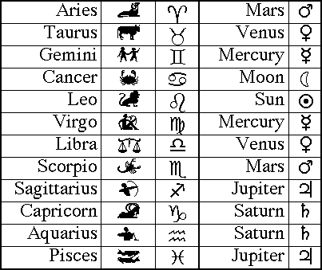
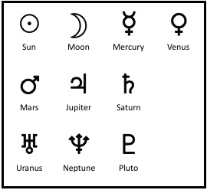
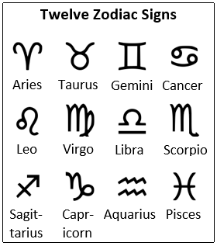

Slide 9
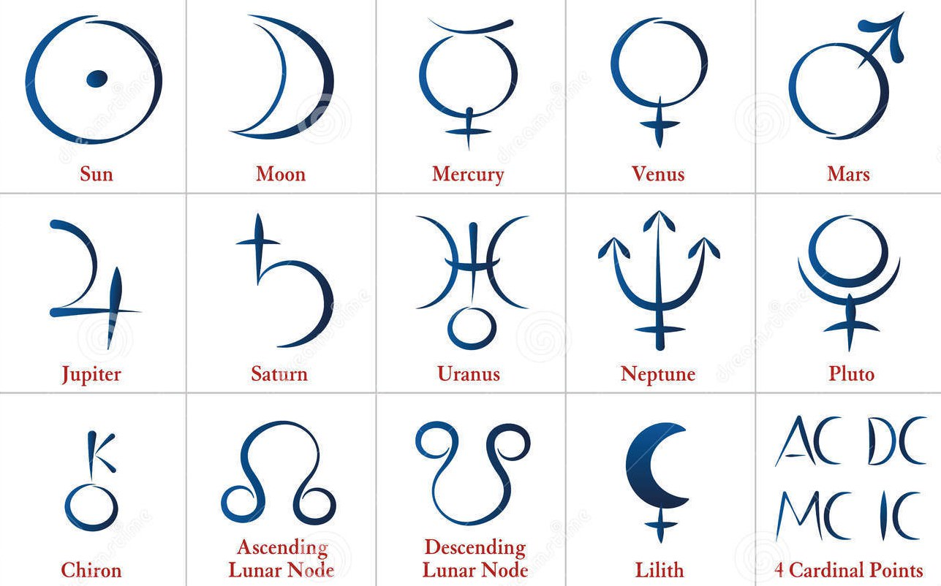

Slide 10
LOGO
Horoscope | Service | Astro shop | Ask astrologer | About Us
Daily Horoscope | Career | Horoscope
Weekly Horoscope | Marriage | Gems
Monthly Horoscope | Children | Rudraksh
Yearly Horoscope | Health
Tomorrow ‘s Horoscope | Business
 | Wealth

Slide 11
About Us
The website is managed by a group of professionally qualified astrologers, who practice the scientific approach in decoding the horoscopes.
Each horoscope is discussed amongst us with all relevant divisional charts, Ashtakavarga, Dasa n Transit & all principles applied that are relevant to the subject of the question.
The website aims at providing guidance based on principle of Vedic astrology and not instil fear and exploit people for financial gains.

Slide 12
ASK Astrologer
Please share following details for free prediction
Name
Date of Birth
Time of Birth
Place of Birth
Email Id
Phone No.

